Slide 1


Basic JavaScript
Excellence in Software Engineering

Slide 2
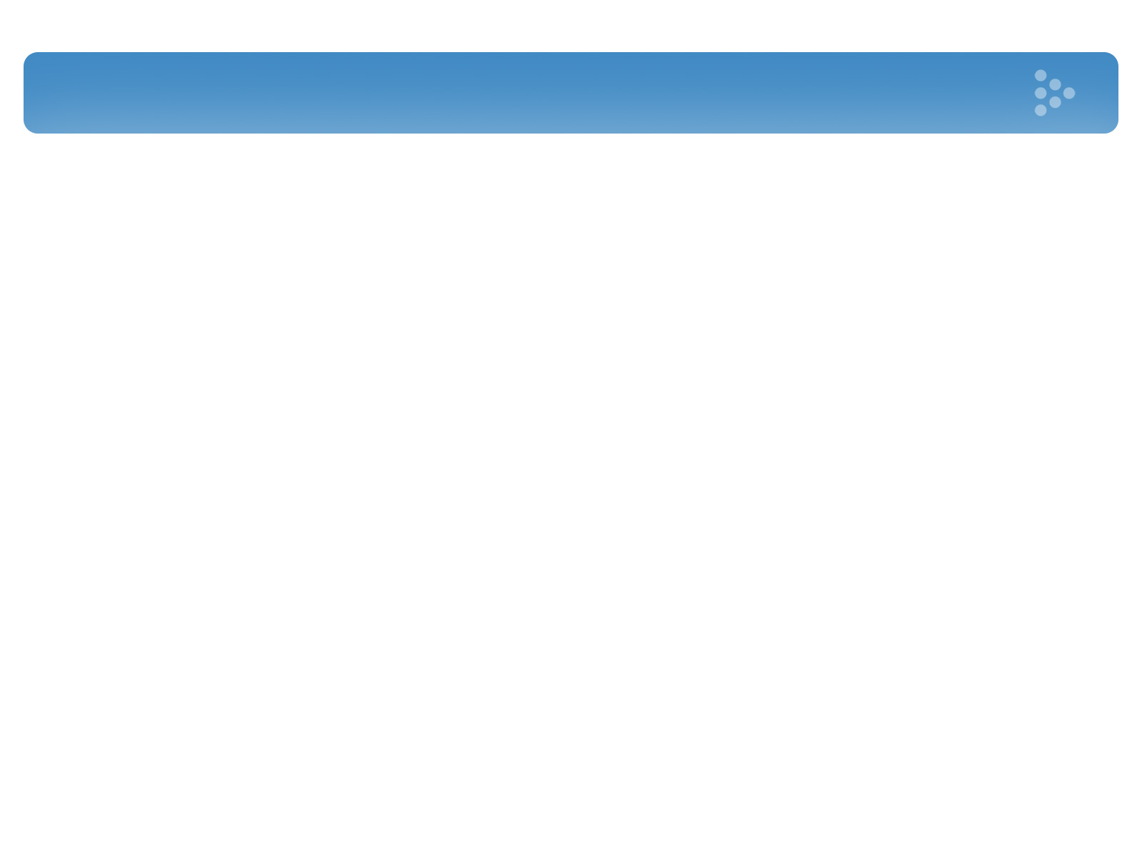
Agenda
History and versions
Lexical structure
Data types
Variables
Operators and statements

Slide 3
History and versions
Netscape
1995 – by Brendan Eich in Netscape Communication
1996 – JavaScript 1.1 with Netscape 3.0
1997 – ECMA-262 first edition
1997 – JavaScript 1.2 with Netscape Navigator 4.0
2000 – JavaScript 1.5 for ECMAScript 3 edition
2006-2008 – JavaScript 1.6-1.8 with Firefox 2.0, 3.0
2009 – JavaScript 2.0 for ECMAScript edition 5
ECMAScript dialects
1996 – JScript with Internet Explorer 3.0
2000 – ActionScript with Macromedia Flash 5.0

Slide 4

“And we were pushing it as a little brother to Java, as a complementary language like Visual Basic was to C++ in Microsoft’s language families at the time.”
Brendan Eich
https://brendaneich.com/

Slide 5
Lexical structure
Case sensitivity
onclick Onclick onClick ONCLICK
Identifiers:
var name; var _name; var $name;
Reserved words
if, else, new, null
class, const, extends, import

Slide 6

Comments
// This is single line comment
/*
Comment with
Multiple lines
*/
/* one comment */ // another one

Slide 7
Whitespaces and linebreaks
var name = "name";
var anotherName = "another name";
if ((name && anotherName)
&& (anotherName.length > name.length)
) {
console.log("anotherName is longer");
}

Slide 8
Optional semicolons
var a = 1
var b = 2
a = 1; b = 2;
var c
var y = x + f
(a+b).toString()
=
10
console.log(c)
var y = x + f
(a+b).toString()
var y = x + f(a+b).toString();

Slide 9
Data types
Simple types
Numbers 3.14
Strings “Hello World!”
Boolean true false
Special types
null
undefined
Objects

Slide 10
Built-in constructors
Object
Number // Object wrapper
String // Object wrapper
Boolean // Object wrapper
Array
Function
Date
Math
RegExp
Error

Slide 11
Number
Only one number type (No integers)
64-bit floating point values
Sign can be chaged with –
Range: Number.MIN_VALUE - Number.MAX_VALUE

Slide 12
Number
Integer literals
0
3
100000000
Floating points literals
[digits][.digits][(E|e)[(+|-)]digits]
3.14
342.13
.999
6.02e23 // 6.02 × 10²³
1.4738223E-32 // 1.4738223 × 10⁻³²

Slide 13
Number
Simple operators:
+, -, *, /, %
Division by zero:
1/0 // => ?
-1/0 // => ?
Number.Infinity/Number.Infinity //=> ?

Slide 14
Number
Math.round(.6) // => 1.0: round to the nearest integer
Math.ceil(.6) // => 1.0: round up to an integer
Math.floor(.6) // => 0.0: round down to an integer
Math.abs(-5) // => 5: absolute value
Math.max(x,y,z) // Return the largest argument
Math.min(x,y,z) // Return the smallest argument
Math.random() // Pseudo-random number x where 0 <= x < 1.0
Math.sqrt(3) // The square root of 3

Slide 15
Number
Infinity // A read/write (ES3)
NaN // A read/write (ES3)
Number.Infinity //readonly
Number.NaN //readonly
Number.POSITIVE_INFINITY
Number.MAX_VALUE + 1
Number.NEGATIVE_INFINITY
Number.MAX_VALUE – 1
Number.NaN
NaN === NaN ? How to check? X != X

Slide 16
Number
Rounding Errors
var x = .3 - .2;
var y = .2 - .1;
x == y // => false
x == .1 // => false: .3-.2 is not equal to .1
y == .1 // => true: .2-.1 is equal to .1

Slide 17
String
Sequence of 0 or more 16-bit characters
No separate character type
Strings are immutable
Similar strings are equal ( == )

Slide 18
String
Literal
var simpleString = “test”;
typeof simpleString == “string”
Constructor function
var stringObject = new String(“test”);
typeof stringObject == “object”
Global function
var string = String(value);

Slide 19
String
String literals can use single or double quotes
"" // The empty string: it has zero characters
'testing'
"3.14"
'name="myform"'
"Wouldn't you prefer O'Reilly's book?"
"This string\nhas two lines"
"π is the ratio of a circle's circumference to its diameter"

Slide 20
String
Escape Sequences in String Literals with backslash
‘can\’t’
“\””
“yes\no”
“yes\\no”

Slide 21
Working with Strings
Concatenation
var msg = “Hello, “ + “world”; // string “Hello, world”
var greeting = "Welcome to my blog," + " " + name;
Length
msg.length

Slide 22
Working with Strings
Methods
var s = "hello, world" // Start with some text
s.charAt(0) // => "h": the first character
s.charAt(s.length-1) // => "d": the last character
s.substring(1,4) // => "ell
s.slice(1,4) // => "ell": same thing
s.indexOf("l") // => 2: position of first letter l

Slide 23
Working with Strings
Do you remember thar strings are immutable?
var a = “lower”;
var b = a.toUpperCase();
console.log(a) // => ?
var u = “test”;
u.replace("e", "o") // returns “tost”
console.log(u) // => ?

Slide 24
Boolean
A boolean value represents truth or falsehood, on or off, yes or no. There are only two possible values of this type.
var flagTrue = true;
var flagFalse = false;

Slide 25
Boolean
Type Conversions:
false
false
null
undefined
""
0
- 0
Number.NaN
NaN
true
“false”
“0”
100
“some string”
{}
[]

Slide 26
Boolean
Boolean function:
var booleanVariable = Boolean(someValue);
Constructor:
var booleanVariable = new Boolean(someValue);
returns true if value is truthy
returns false if value is falsy

Slide 27
Boolean
!! operator
var booleanVariable = new Boolean("false");
var booleanVariable = !!"false";
!!{} // => ?
!![] // => ?
!![].length // => ?
!!5 // => ?
!!-100 // => ?
!!NaN // => ?

Slide 28
Boolean
if (a == 4) {
b = b + 1;
}
else {
a = a + 1;
}
If need to check null:
if (o !== null) ...
Short form: If(o) If(!o)
Logical operators return Boolean as well as Comparison
if ((x == 0 && y == 0) || !(z == 0)) {
// x and y are both zero or z is non-zero
}

Slide 29
null and undefined
null - language keyword that evaluates to a special value that is usually used to indicate the absence of a value.
undefined - represents value of variables that have not been
initialized and the value you get when you query the value of an object property or array element that does not exist.
null – expected value absence
undefined – unexpected value absence

Slide 30
null
typeof null // => “object” – special empty object
var test = null;
if (test !== null) {…}
To string:
var a = null; a.toString(); // => ?
console.log(“string” + null); // => ?
To number: console.log(100 + null); // => ?
To Boolean: console.log(!!null); // => ?

Slide 31
undefined
typeof undefined // => “undefined”
undefined – predefined global variable, can be overridden in ES3 fixed in ES5
To string:
var a; a.toString(); // => ?
console.log(“string” + a); // => ?
To number: console.log(100 + a); // => ?
To Boolean: console.log(!!a); // => ?

Slide 32
undefined
var test; // => test ?
var test = {}; // => test.a ?
var test = [{}]; // => test[0].a ?
var test = function() {}; // => test() ?
var test = function(a,b,c) {
console.log(“a: ” + a);
console.log(“b: ” + b);
console.log(“c: ” + c);
};
test(1,2); // => ?

Slide 33
Object
An object is an unordered collection of properties, each of which has a name and a value.
var person = { firstName:”John”, lastName:”Doe”, age:50, eyeColor:”blue” };

Slide 34
Creating Objects with new
Create an empty object:
var o = new Object(); // same as {}
Create an empty array:
var a = new Array(); // same as []
Create a Date object:
var d = new Date(); // current time

Slide 35
Object.create()
o1 inherits properties x and y:
var o1 = Object.create({x:1, y:2});
o2 inherits no props or methods:
var o2 = Object.create(null);
o3 is like {} or new Object():
var o3 = Object.create(Object.prototype);

Slide 36
Object.prototype
var foo = { x: 10, y: 20 };
console.log(foo.constructor == Object);
console.log(foo.toString() == "[object Object]");
console.log(foo.valueOf() == foo );
console.log(foo.hasOwnProperty("x") == true);
console.log(foo.hasOwnProperty("toString") == false);
console.log(foo.propertyIsEnumerable("x") == true );
console.log(Object.prototype.isPrototypeOf(foo) == true);

Slide 37
Querying and Setting Properties
Set values:
book.edition = 6;
book["main title"] = "ECMAScript";
book.getEdition = function(){return this.edition};
book.42 = “42”; // => Error
book[42] = “42”;
Get values:
var author = book.author;
var name = author.surname
var title = book["main title"]
var edition = book.getEdition();
var number = book.42 // => Error
var number = book[“42”];

Slide 38
Property Access Errors
var foo = {x: 5, y: 100};
console.log(foo.bar); // => undefined
console.log(foo.bar.baz);
// => TypeError: Cannot read property 'baz' of undefined
Make check:
If (foo && foo.bar) {
var qux = foo.bar.baz
}

Slide 39
Objects As Associative Arrays
var book = {
author: "John Doe",
title: "some title",
pages: 550,
parts: {
introduction: {title:"Introduction", pages: 25},
history: {title:"History", pages: 25, periods: [5, 10]}
}
}
for (prop in book) {
if (prop === "author") {
console.log("The author is " + book[prop]);
}
}

Slide 40
Deleting Properties
The delete operator removes a property from an object:
var foo = {
x: 100,
y: 200,
getSum: function() {
return this.x + this.y;
}
}
delete foo.x // returns true
console.log (foo.x) // => undefined
delete foo.getSum
console.log (foo.getSum) // => undefined

Slide 41
Serializing Objects
Object serialization is the process of converting an object’s state to a string from which it can later be restored.
var obj = {x:1, y:{z:[false,null,""]}};
var objSringified = JSON.stringify(obj);
// => '{"x":1,"y":{"z":[false,null,""]}}'
var parsedObj= JSON.parse(objSringified);
// parsedObj is a copy of obj

Slide 42
Array
An array is an ordered collection of values. Each value is called an element, and each element has a numeric position in the array, known as its index.
untyped nature:
var arr = [ 1.1, true, "a", {} ];

Slide 43
Creating Arrays as literals
Literals:
var empty = []; // An array with no elements
var primes = [2, 3, 5, 7, 11];
With expressions:
var base = 1024;
var table = [base, base+1, base+2, base+3];
Array literals can contain object literals or other array literals:
var b = [[1,{x:1, y:2}], [2, {x:3, y:4}]];

Slide 44
Creating Arrays with new
With no arguments:
var a = new Array(); // []
With a single numeric argument - length:
var a = new Array(10); [,,,,,,,,,]
Explicitly specify elements:
var a = new Array(5, 4, 3, 2, 1, “foo, bar");

Slide 45
Reading and Writing Array Elements
Use literals in []:
var a = ["world"];
var value = a[0];
a[1] = 3.14;
Use expressions in []:
var i = 2;
a[i] = 3;
a[i + 1] = "hello";
a[a[i]] = a[0];

Slide 46
Iterating Arrays
Property length:
var a = [1,2,3,4,5];
a.length // => 5
“for” loop:
var result = [];
for(var i = 0; i < a.length; i++) {
// for each index in the array
result.push(a[i]);
}

Slide 47
Array Methods
Array.join()
var a = [1, 2, 3]; // new array with these three elements
a.join(); // => "1,2,3"
a.join(" "); // => "1 2 3“
Array.reverse()
var a = [1,2,3];
a.reverse().join() // => "3,2,1" and a is now [3,2,1]
Array.sort()
var a = new Array("banana", "cherry", "apple");
a.sort();
var s = a.join(", "); // s == "apple, banana, cherry“
Array.concat()
var a = [1,2,3];
a.concat(4, 5) // Returns [1,2,3,4,5]

Slide 48
Array Methods
Array.slice()
var a = [1,2,3,4,5];
a.slice(0,3); // [1,2,3]
push() and pop()
var stack = []; // stack: []
stack.push(1,2); // stack: [1,2] Returns 2
stack.pop(); // stack: [1] Returns 2
unshift() and shift()
var a = []; // a:[]
a.unshift(1); // a:[1] Returns: 1
a.unshift(22); // a:[22,1] Returns: 2
a.shift(); // a:[1] Returns: 22
Array.toString()
[1,2,3].toString() // '1,2,3'
["a", "b", "c"].toString() // 'a,b,c'
[1, [2,'c']].toString() // '1,2,c'

Slide 49
Array Methods ES5
forEach()
var data = [1,2,3,4,5];
//increment each array element
data.forEach(function(v, i, a) { a[i] = v + 1; });
data // => [2,3,4,5,6]
map()
var a = [1, 2, 3];
var b = a.map(function(x) { return x*x; }); // b is [1, 4, 9]
filter()
var a = [5, 4, 3, 2, 1];
var smallvalues = a.filter(function(x) { return x < 3 }); // [2, 1]
indexOf()
var a = [0,1,2,1,0];
a.indexOf(1) // => 1: a[1] is 1

Slide 50
Function
A function is a block of JavaScript code that is defined once but may be executed, or invoked, any number of times.
function printProps(o) {
for(var p in o) {
console.log(p + ": " + o[p] + "\n");
}
}

Slide 51
Nested Functions
function calcHypotenuse(a, b) {
function square(x) { return x*x; };
return Math.sqrt(square(a) + square(b));
}

Slide 52
Invoking Functions
as functions:
function printProps(o) {
for(var p in o) {
console.log(p + ": " + o[p] + "\n");
}
}
printProps({x:1}); // => x: 1
as methods:
var calculator = {
x: 1,
y: 1,
calc: function() {this.result = this.x + this.y;}
};
calculator.calc();
console.log(calculator.result); // => 2

Slide 53
Constructor Invocation
function Person (name, age) {
this.name = name;
this.age = age;
this.getAge = function(){return this.age;}
};
// => “return” is missed
Person.printName = function() {console.log(this.name)};

Slide 54
Constructor Invocation
// make some properties “private”
function Person (name, age) {
this.name = name;
this.age = age;
this.getAge = function(){return this.age;}
return {getAge: this.getAge.bind(this)};
};

Slide 55
Constructor Invocation
// put common functions to prototype
function Person (name, age) {
this.name = name;
this.age = age;
};
Person.prototype.getAge = function(){return this.age;};
var boy = new Person(“Mike”, 20);
boy.hasOwnProperty(); // => false
boy.getAge(); // => 20

Slide 56
Functions As Values
function square(x) { return x*x; }
Can be assigned to another variable and still work the same way:
// s refers to the same function that square
var s = square;
square(4); // => 16
s(4); // => 16
Can be assigned to object properties rather than variables:
// An object literal with method
var o = {square: function(x) { return x*x; }};
var y = o.square(16); // y equals 256
Can be assigned to array elements:
// An array literal
var a = [function(x) { return x*x; }, 20];
a[0](a[1]); // => 400

Slide 57
Functions As Namespaces
function myModule() {
// Module code
// Any variables are local
// Global namespace is not polluted
}
myModule(); // call function to create module
var myApp = {};
(function(module, undefined) {
//
// Module code
//
}(myApp.first = myApp.first || {}));

Slide 58
Closure
Lexical scoping – is a key to understand.
var scope = "global scope"; // A global variable
function checkscope() {
var scope = "local scope"; // A local variable
function f() { return scope; };
return f();
}
checkscope() // => “local scope”
var scope = "global scope"; // A global variable
function checkscope() {
var scope = "local scope"; // A local variable
function f() { return scope; };
return f; // no ()
}
checkscope()() // => ??

Slide 59
Closure
var uniqueNumber = (function() {
var counter = 0;
return function() { return counter++; };
}());

Slide 60
The Global Object
The global object is a regular JavaScript object that serves a very important purpose: the properties of this object are the globally defined symbols that are available to a JavaScript program.
On JavaScript interpreter start:
global properties like undefined, Infinity, and NaN
• global functions like isNaN(), parseInt() and eval()
• constructor functions like Date(), RegExp(), String(), Object(), Array()
• global objects like Math and JSON

Slide 61
The Global Object
Client-side Javascript:
var global = window; // reference to Window object
//Contains core methods + browser objects and methods,
//like: localStorage, iframes etc..
console.log(this);
console.log(window);
console.log(Window);

Slide 62
Object Wrappers
Strings, numbers, booleans are not objects,
so why do they have properties?
var s = "hello world!"; // A string
var world = s.substring(s.indexOf(" ")+1, s.length);
var s = "test"; // Start with a string value.
s.len = 4; // Set a property on it.
var t = s.len; // Now query the property.

Slide 63
Object Wrappers
“test” === “test” //=> ?
“test” == “test” //=> ?
“test” == new String(“test”) //=> ?
“test” === new String(“test”) //=> ?
new String(“test”) == new String(“test”) //=> ? new String(“test”) === new String(“test”) //=> ?
typeof(“test”) //=> ?
typeof(new String(“test”)) //=> ?

Slide 64
Object Wrappers
We know that we can:
var A = new String("test“); //=> String object
var B = new Number(1); //=> Number object
var C = new Boolean(true); //=> Boolean object
We do:
var a = "test“;
var b = 1;
var c = true;

Slide 65
Immutable Primitive Values and Mutable Object References
Primitives (strings, numbers, Booleans, null, undefined):
Immutable, no way to change value
var s = "hello"; // Start with some lowercase text
s.toUpperCase(); // Returns "HELLO", but doesn't alter s
s // => "hello": the original string has not changed
Compared by value
var a = “test”; var b = “test”;
a == b // => true

Slide 66
Immutable Primitive Values and Mutable Object References
Objects:
Mutable, value can be changed
var o = { x:1 }; // Start with an object
o.x = 2; // Mutate it by changing the value of a property
o.y = 3; // Mutate it again by adding a new property
Compared by reference, not by value
var o = {x:1}, p = {x:1};
o === p // => false
var a = [], b = [];
a === b // => false
var a = [];
var b = a;
b[0] = 1;
a[0] // => 1:
a === b // => true

Slide 67
Type conversion
Interpreter will always convert value to the expected type.
10 + " objects" // => "10 objects".
"7" * "4" // => 28
var n = 1 - "x";
// => NaN

Slide 68
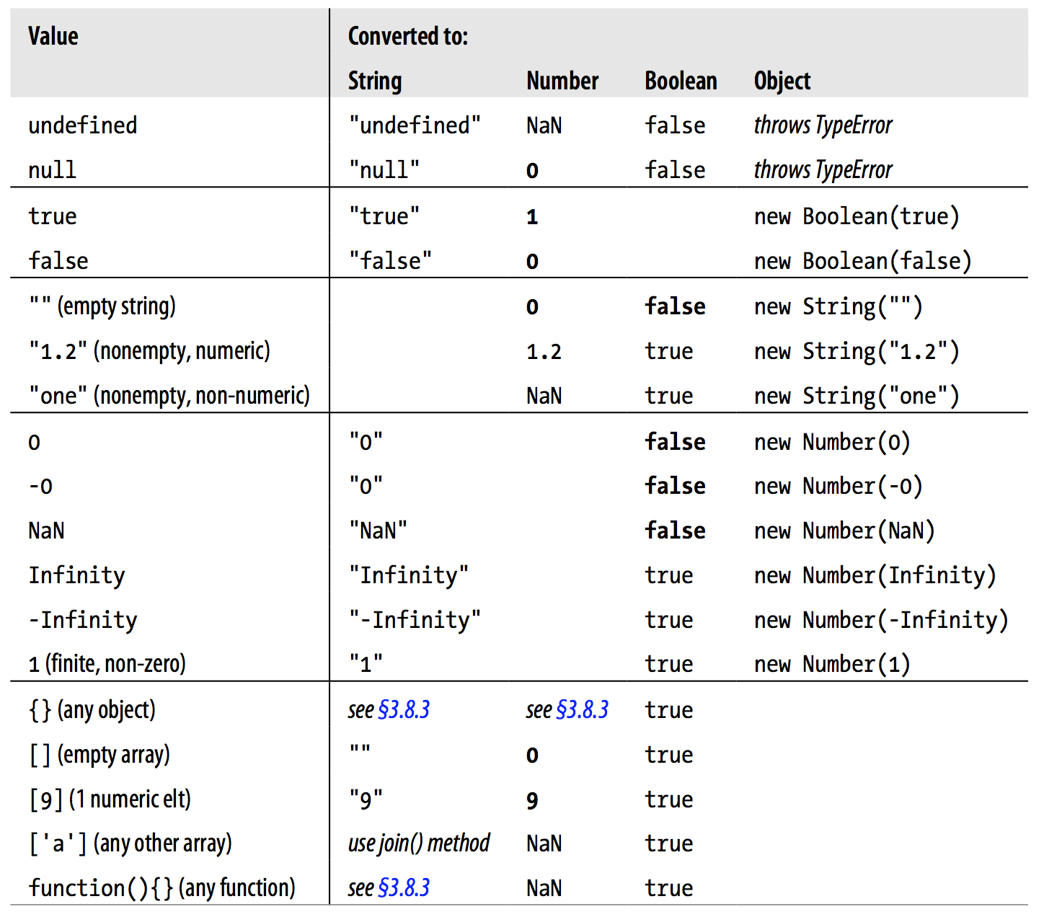
Type conversion

Slide 69
Type conversion
Conversions and Concatenation:
Both operands are numbers:
100 + 500 // => 600
Otherwise:
“plus” + 100 + 500 // => “plus100500”

Slide 70
Type conversion
Conversions and Equality:
'' == '0' // false
0 == '' // true
0 == '0' // true
false == 'false' // false
false == '0' // true
false == undefined // false
false == null // false
null == undefined // true
It is always better to use === and !==, which do not do type conversion.

Slide 71
Explicit Type conversion
Constructors:
new Number("3") // => 3
new String(false) // => "false"
new Boolean([]) // => true
new Object(3) // => new Number(3)
Operators
x + "" // Same as String(x)
+x // Same as Number(x)
!!x // Same as Boolean(x). Note double
Global functions
parseInt("3 blind mice") // => 3
parseFloat(" 3.14 meters") // => 3.14
parseInt("-12.34") // => -12

Slide 72
Variables
Declaration:
var test;
var sum;
Single var pattern:
var test, sum;
With initialization:
var message = "hello";
var i = 0, j = 0, k = 0;
Dynamic nature:
var test = 10;
test = "ten";

Slide 73
Variable Scope
The scope of a variable is the region of your program source code in which it is defined.
var scope = "global scope"; // A global variable
function checkscope() {
var scope = "local scope"; // A local variable
function nested() {
var scope = "nested scope"; // A nested scope
return scope; // Return the value in scope here
}
return nested();
}
checkscope() // => ?

Slide 74
Function Scope
Variables are visible within the function in which they are defined and within any functions that are nested within that function.
function test(o) {
var i = 0; // i is defined throughout function
if (typeof o == "object") {
var j = 0; // j is defined everywhere, not just block
for(var k=0; k < 10; k++) { // k is defined everywhere console.log(k);
}
console.log(k); // k is still defined: prints 10
}
console.log(j); // j is defined, but may not be initialized
}

Slide 75
Hoisting
var scope = "global";
function f() {
console.log(scope); // => ?
var scope = "local"; console.log(scope); // => ?
}

Slide 76
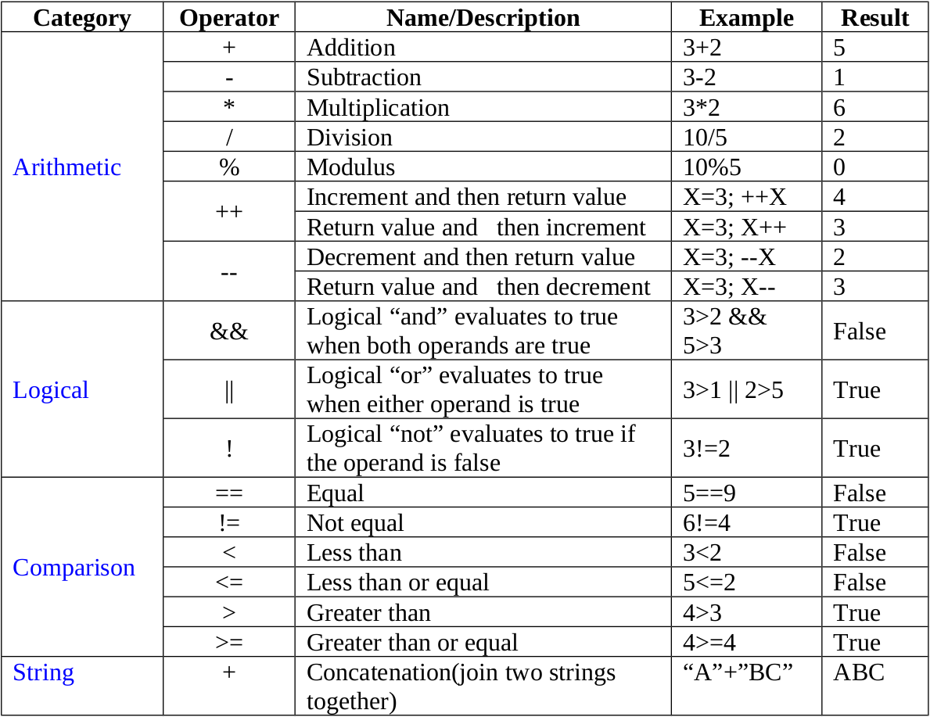
Operators

Slide 77
Operators
delete //Remove a property
typeof //Determine type
void // returns undefined
instanceof // checks object class

Slide 78
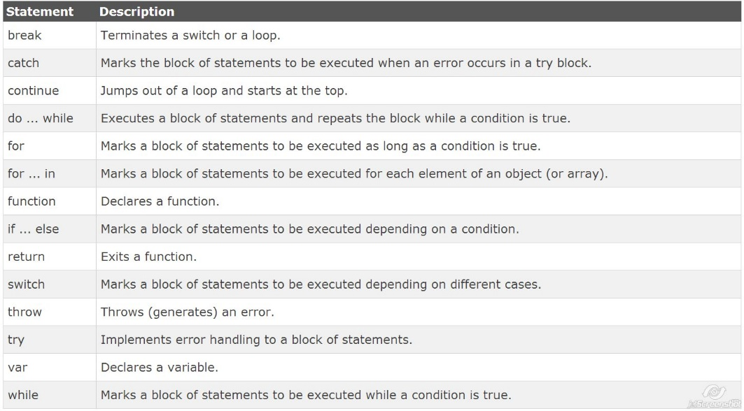
Statements

Slide 79
Questions?

Slide 80
References
Book: JavaScript: The Definitive Guide, 6th Edition
By David Flanagan
https://developer.mozilla.org/en-US/docs/Web/JavaScript
http://learn.javascript.ru/
http://www.w3schools.com/
http://addyosmani.com/blog/
http://www.paulirish.com/
http://dmitry.baranovskiy.com/

Slide 81
TODO
Quick test from Dmitry Baranovskiy:
http://dmitry.baranovskiy.com/post/so-you-think-you-know-javascript
A lightning talk by Gary Bernhardt from CodeMash 2012:
https://www.destroyallsoftware.com/talks/wat
Screencast from Paul Irish:
http://www.paulirish.com/2010/10-things-i-learned-from-the-jquery-source/
Weekly newsletter:
http://javascriptweekly.com/
Daily newsletter:
http://dailyjs.com/

